Slide 1
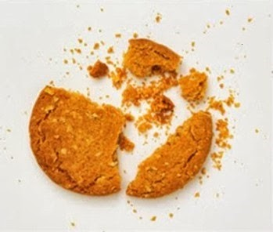

Test Automation Using Selenium
Fair Hike Academy
That’s the way the cookie crumbles!
Session 12: Selenium WebDriver – Handling WebElements
Mentor : Naresh Vulli, CSTE, PAHM.
fairhike@gmail.com www.fairhike.blogspot.com | www.facebook.com/fairhike

Slide 2
Today’s Topics
Recap
Textbox
Masked Fields
Checkbox and Radio button
Hyperlinks or links
Dropdown box
List - Collection of web elements
Takeaways or Exercise

Slide 3
Textbox
//Textbox - name
driver.findElement(By.name("firstname")).sendKeys("John");
driver.findElement(By.name("lastname")).sendKeys("Kevin");
//Textbox - id
driver.findElement(By.id("u_0_4")).sendKeys("3698532458");

Slide 4
Masked Fields
//Textbox - Masked
driver.findElement(By.cssSelector
("input[name = \"reg_passwd__\"]")).sendKeys("password@1");

Slide 5
Radio Button or Check Box
//Radio Buttons
driver.findElement(By.id("u_0_7")).click();

Slide 6
HyperLinks or Links
//linktext
driver.findElement(By.linkText("Terms")).click();
//partial linktext
driver.findElement(By.partialLinkText("Policy")).click();

Slide 7
Dropdown
//DROPDOWN - Select by Index
Select day = new Select(driver.findElement(By.id("day")));
day.selectByIndex(4);
//DROPDOWN - Select by Value
Select month = new Select(driver.findElement(By.id("month")));
month.selectByValue("4");
//DROPDOWN - Select by visibleText
Select yr = new Select(driver.findElement(By.id("year")));
yr.selectByVisibleText("2001");

Slide 8
List - Collection of web elements
List<WebElement> elem = driver.findElements(By.cssSelector("input[type = \"checkbox\"]"));
for(WebElement chk:elem)
{
chk.click();
}

Slide 9
Takeaway or Exercise
Write and execute a program for Naukri user registration

Slide 10
Q & A

Slide 11
Thank You ☺

